Slide 1
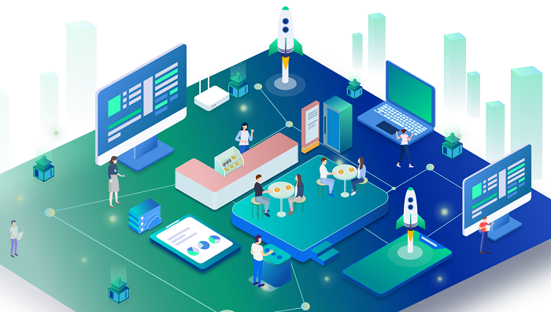
Integrated Smart and Contactless Ordering System
FURTHER STEP TOWARDS DIGITALIZED LIFE
K. Verma, S. Chen, X. Zhou

Slide 2
Objectives of the proposal
Project Goals | Alignment with Organizational Strategy
The primary objectives of implementing the Integrated Smart and Contactless Ordering System are: (1) Enhance Customer Experience (2) Improve Operational Efficiency (3) Reduce Labor Costs (4) Increase Revenue Opportunities (5) Ensure Scalability & Security | This proposal directly supports the restaurant chain’s strategic priorities by: (1) Driving Digital Transformation (2) Boosting Profitability (3) Improving Customer Retention (4) Enabling Data-Driven Decisions (5) Future-Proofing Operations By achieving these objectives, the proposed system will deliver both immediate operational benefits and long-term strategic value.
Notes:
Digital menu integration:
-Develop a user-friendly digital menu where customers can browse and select dishes from their phone or tablet device.
AI order priority:
-Implement intelligent algorithms to automatically schedule and queue orders based on kitchen load and order priority.
Real-time order tracking:
-Provides an interface that enables customers, servers, and kitchen staff to view order status in real time.
Contactless payment options:
-Integrate multiple payment methods, including credit cards, mobile payments and ledger splitting capabilities to ensure customers can conveniently complete transactions.
User training and support:
- Provide employees with the necessary training and support to ensure they can use the new system smoothly.
Follow-up analysis and reporting tools:
The development of specialized data analysis and reporting tools is not included, and although order data will be collected, the analysis component will be left to a later stage.
Multi-language support:
The initial release will only support major languages and will not include additional multilingual capabilities.
Table reservation system
Online payment platform integration

Slide 3
Recap of the Business Problem
The restaurant chain currently faces several critical challenges due to its reliance on manual order processing:
(1) Order inaccuracies leading to customer frustration and increased food waste.
(2) Longer wait times during peak hours, negatively impacting the dining experience.
(3) High labor dependency, driving up operational costs.
(4) Inefficient payment processes
These issues hinder the chain’s ability to compete in an increasingly tech-driven, fast-paced dining industry, where customers expect speed, convenience, and seamless service.
Notes:
Clear project objectives:
Make sure the project goals are clear and measurable so that the team can focus on achieving them.
User - Friendly Product:
User-friendly, functional product makes it easier for customers to participate in it.
Effective communication:
Establish good communication channels to ensure that all stakeholders have timely access to information and participate in the decision-making process.
Strong project management:
Hire an experienced project manager who is responsible for the overall planning, execution and monitoring of the project to ensure that the project is completed on time and on budget.

Slide 4
Recap of Current System Challenges
The existing manual ordering system presents the following key inefficiencies:
(1) Human Error in Orders
(2) Bottlenecks in Service
(3) Labor-Intensive Processes
(4)Outdated Payment Methods
(5)Limited Data Insights
By transitioning to an automated, contactless system, the restaurant can resolve these pain points while aligning with industry trends toward digital dining solutions.
Notes:
Teamwork:
Encourage collaboration and knowledge sharing among team members to promote innovation and problem solving.
Ongoing risk management:
Assess project risks regularly and take timely action to reduce the impact of potential problems on project schedule.
Training and Support:
Provide adequate training and support to help employees adapt to the new system and ensure its effective use.
Feedback mechanism:
Establish feedback mechanisms to collect feedback from users and employees in order to continuously improve systems and processes.
Flexible change management:
Set up a flexible change management process to adapt to new requirements and challenges during project implementation.

Slide 5

Candidate Systems
Custom-build
Custom-built, AI-powered ordering system with mobile/tablet access, smart kitchen prioritization, KDS integration, and contactless payments. Fully tailored to UrbanEats’ needs.
Toast POS Cloud
Cloud-based POS with mobile ordering, digital menus, and built-in analytics. Quick to deploy but limited customization.
GloriaLink Add-on
Low-cost plugin system layered on existing POS. Enables basic mobile ordering with minimal setup, but limited scalability and features.
Oracle MICROS Simphony
Enterprise-level POS with advanced tools and analytics. Ideal for large chains but expensive and complex for UrbanEats’ current scale.
Notes:
Candidate 1: custom-build
A fully tailored AI-powered ordering system developed specifically for the organization. It includes mobile/tablet-based self-ordering, kitchen display integration, contactless payments, and smart order prioritization. This system gives us full control and customization to meet organizational goals and improve customer experience.
Candidate 2: toast POS cloud (software as a service)
A robust cloud-based POS system offering fast development, built-in reporting, digital menus, and mobile payment capabilities. It simplifies operations and reduces overhead, though it offers limited customization beyond vendor-supported features.
Candidate 3: gloriaLink add-on (hybrid plugin system)
A low-cost modular option that integrates third-party ordering plug-ins like gloriaFood with existing POS. It enables basic mobile ordering and some automation with minimal infrastructure changes but lacks long-term scalability and advanced AI features.
Candidate 4: oracle MICROS Simphony
A powerful enterprise grade solution designed for large scale operations. It includes deep analytics, multi-location support, and extensive POS features. However, it comes with high costs, long implementation timelines, and more complexity than required at this stage for the organization.

Slide 6
Candidates Alternatives Matrix
Category | Custom build (proposed solution) | Toast POS Cloud (SaaS) | GloriaLink Add-on (Hybrid) | Oracle MICROS Simphony (Enterprise) | Classic Manual Process (Current)
Stakeholders | Tailored for all internal roles; high stakeholder input and buy-in required | End-users adapt to preset SaaS workflows; limited customization | Requires staff to learn plugin workflows; moderate stakeholder training | Requires extensive training; multiple stakeholder teams; rigid structure | All manual interaction; heavy staff dependency
Knowledge | Custom database; real-time syncing; historical data and analytics bulit-in | Cloud hosted data; vendor-controlled; analytics tools included | Uses separate data stores; may not fully sync with existing POS | Centralized database; full analytics and forecasting; requires strong IT backend | Paper-based; no data history or analytics
Processes | Reengineered end-to-end ordering, prep, and payment; built for speed and accuracy | Streamlined POS and order process; fixed by vendor updates | Limited process change; adapts to existing POS setup | Highly structured; best for chains with complex workflows | Legacy processes; no automation; high room for error
Communications | Real-time alerts, order status, and receipts; internal message routing | Limited internal messaging; relies on UI dashboards | Some notifications available; no advanced routing | Structured alerts, screens, and back-office notifications; configurable per site | Verbal communication only; high risk of miscommunication
Notes:
This slide compares all the candidate systems based on four core categories - stakeholders, knowledge management, processes, and communication.
Our proposed solution stands out because it is the only system designed from ground up for our internal workflows. It gives us maximum control and internal alignment.
Toast POS and GloriaLink offer quicker solutions and are easier to deploy, they offer limited customization and assume that out staff will adapt to pre-set workflows - which may cause friction in real use.
On the communication and process fronts, our solution enables real-time messaging and smart routing of order statues, which directly addresses delays and miscommunication issues in the current manual setup.
The Oracle MICROS system is powerful but over engineered for us — it’s better suited for massive chain operations.

Slide 7
What matters?
Criteria | High-score Candidate Traits
Operational | Supports all workflows, intuitive, improves accuracy and speed, reduces workload.
Cultural | Staff buy-in, easy to adopt, low resistance, aligns with company values.
Technical | Supported by current IT infrastructure, compatible tools, has internal support.
Schedule | Fast to roll out, doesn’t interrupt ongoing operations, requires minimal custom prep.
Economic | Strong ROI, fast payback (<3 years), clear and measurable cost savings.
Legal | Meets all compliance needs (PCI, ADA, GDPR if needed), with built-in auditing.
Notes:
What we prioritized in our scoring model -
The most important dimension is Operational feasibility - can the system actually work with our staff and workflow in real time, especially during rush hour.
Economic feasibility also holds a major weight- we need to show a strong ROI, fast payback and tangible cost savings.
Technical and schedule feasibility ensure that we’re capable of deploying the system smoothly, and without disruption.
We did assign some weight to cultural and legal feasibility but they are relatively lower because we expect resistance to decrease with proper training, and most solutions already comply with basic regulations.

Slide 8
Feasibility Matrix
Criteria | Wt. | Custom build (proposed solution) | Toast POS Cloud (SaaS) | GloriaLink Add-on (Hybrid) | Oracle MICROS Simphony (Enterprise)
Operational | 30% | Fully supports all custom workflow, high user adoption due to tailored design SCORE: 95 | Supports most restaurant functions, but limited to SaaS-defined. SCORE: 85 | Supports basic ordering and menu integrations; lacks support for advanced workflows. SCORE: 75 | Supports advanced workflows but may be overkill for the organization and harder to tailor. SCORE: 80
Cultural | 5% | Staff input integrated during design; medium adjustment needed. SCORE: 85 | SaaS adoption is common; generally accepted. SCORE: 90 | Requires partial retraining; some staff resistance expected. SCORE: 70 | Significant cultural shift and training needed; high maintenance risk. SCORE: 65
Technical | 20% | Developed in-house with full IT support; uses modern tools. SCORE: 90 | Vendor-managed; reliable cloud architecture. SCORE: 85 | Integration issues with existing POS may arise; less stable. SCORE: 75 | Technically advanced; needs IT team and infrastructure. SCORE: 90
Schedule | 10% | Estimated 6-9 months for development and testing. SCORE: 75 | 2-3 months implementation time. SCORE: 90 | 1-2 months for setup and testing. SCORE: 85 | 9-12 months including training and migration. SCORE: 70
Notes:
Operational feasibility — custom building scored highest here due to its alignment with internal workflows and AI-based kitchen prioritization, which streamlines both service and kitchen output. Toast POS and Oracle both performed well but lack the same level of process tailoring. GloriaLink is functional but too basic to handle our full operational needs.
Cultural feasibility — gloriaLink and Toast POS score well due to minimal training needs, while Oracle has a steep learning curve and higher change resistance. Custom-building scores well here too, as it incorporates staff input from the beginning, ensuring smoother adoption despite being a new platform.
Technical feasibility — Toast POS and Oracle scored well, as they offer mature, extremely supported platforms. Custom-building also scored high, since it will be built with internal IT capabilities and scalable technologies. GloriaLink scores lower here due to known integration issues with legacy POS systems.
Schedule feasibility — gloriaLink and Toast can be launched within 2-3 months. Oracle would take 9-12 months. Custom building lands in the middle, needing 6-9 months due to design, development and testing. While not the fastest, custom-building timeline is acceptable given the long-term benefits.

Slide 9
Feasibility Matrix (cont.)
Criteria | Wt. | Custom build (proposed solution) | Toast POS Cloud (SaaS) | GloriaLink Add-on (Hybrid) | Oracle MICROS Simphony (Enterprise)
Economic | 25% | Strong ROI and moderate payback; long-term benefits clear. SCORE: 85 | High ROI and fast payback; subscription model increases total cost over time. SCORE: 85 | Best ROI, lowest cost; limited scalability may reduce future value. SCORE: 80 | Lowest ROI, longest payback period, high initial and ongoing cost. SCORE: 65
Legal | 10% | Designed with compliance in mind (data security, accessibility). SCORE: 90 | Follows standard POS compliance and PCI DSS. SCORE: 90 | Meets minimal compliance standards. SCORE: 85 | Strong legal framework and audit trails. SCORE: 90
Total weighted score | 100% | 91.5 | 86.25 | 78.5 | 75.75
Ranking | — | 1st | 2nd | 3rd | 4th
Notes:
Economic feasibility — Based on our 10-year financial analysis, GloriaLink had the highest ROI at 348% and shortest payback period. Toast also performed strongly. However, UrbanEats SmartServe, with a 98% ROI and nearly $1M net benefit, was competitive and more strategically aligned. Oracle had the weakest performance here, with the longest payback and lowest ROI.
Legal feasibility — all four candidates met or exceeded legal standards, including data protection, accessibility, and PCI compliance. Oracle and Toast score slightly higher due to their extensive built-in auditing tools, but custom building solution was designed and will be built from the ground up with compliance in mind, scoring equally well.
After applying the weightings, custom building led with a score of 91.5 followed by Toast at 86.25, GloriaLink at 78.5 and Oracle at 75.75.
While Toast and GloriaLink offer attractive short-term wins, they don’t deliver the long-term value, flexibility or ownership that custom building offers.

Slide 10
Detailed Financials for a 10-year timeframe

Slide 11
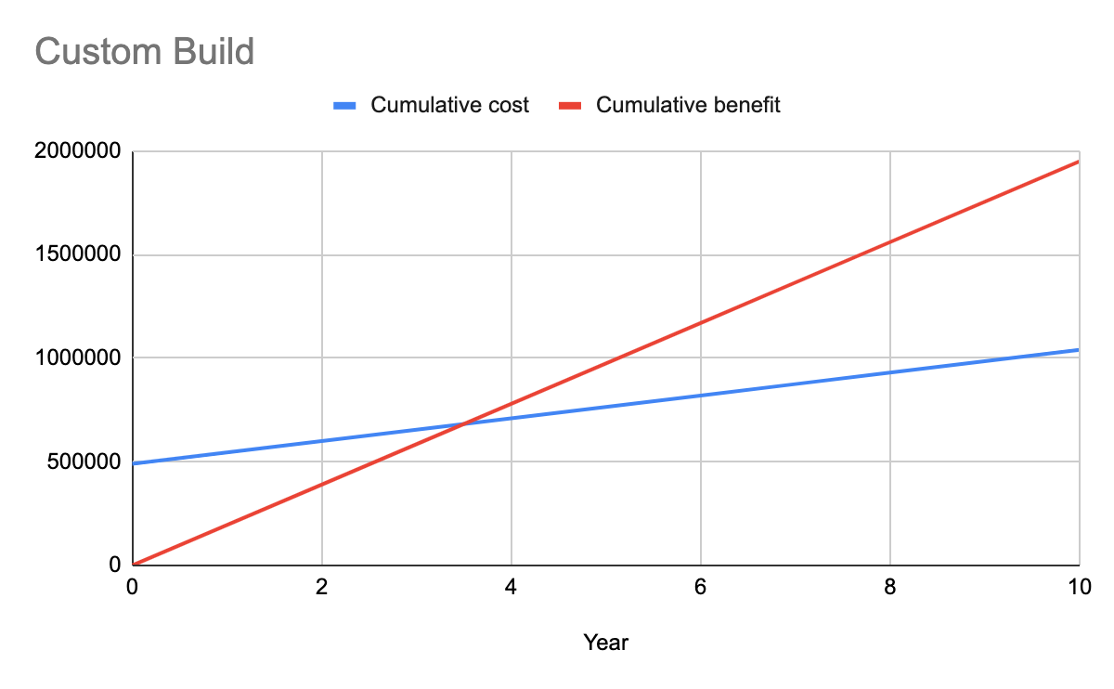
Candidate 1: Custom-build
Item | Amount
Initial Cost | $490,000
Annual operating cost | $55,000
Annual Revenue gain | $160,000
Annual cost savings | $35,000
Total Benefit (10 yrs) | $1,950,000
Total Cost (10 yrs) | $985,000
Net benefit | $965,000
ROI | 98%
Payback period | ~2.8 years
NPV (10 yrs) | $753,000
Notes:
Pros -
Strong long-term ROI (98%) — pays for itself within 3 years and nearly doubles your investment over 10 years.
High annual benefit: $195,000/year from AI-based efficiency, accuracy, and customer upsells.
NPV of $753,000 — great long-term financial value when time is considered.
Full control over development and customization — no vendor lock-in.
Cons -
One of the highest initial cost of all candidates ($490,000) due to AI, KDS, and custom development.
Moderate ongoing costs ($55,000 per year).
Slightly slower payback (~2.8 years) than off-the-shelf tools.

Slide 12
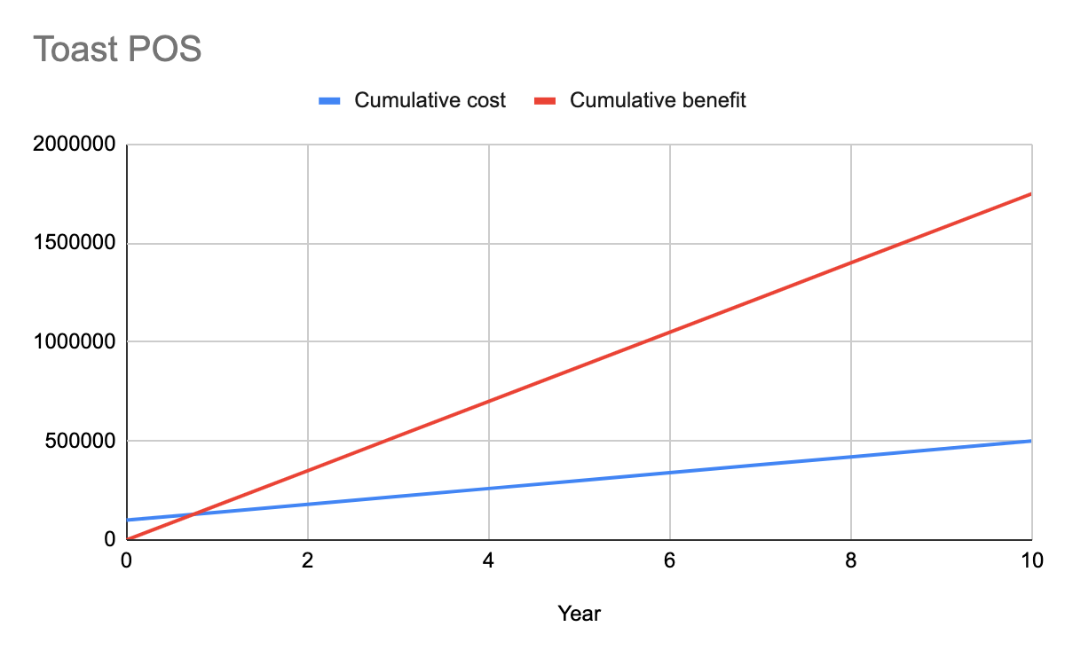
Candidate 2: Toast POS
Item | Amount
Initial Cost | $100,000
Annual operating cost | $40,000
Annual Revenue gain | $145,000
Annual cost savings | $30,000
Total Benefit (10 yrs) | $1,750,000
Total Cost (10 yrs) | $460,000
Net benefit | $1,290,000
ROI | 280%
Payback period | ~1.8 years
NPV (10 yrs) | $865,000
Notes:
Pros -
Low upfront costs ($100,000) and fast payback (~1.8 years).
Excellent ROI (280%) with minimal internal IT burden.
High NPV ($865,000) — solid long-term value.
Reliable, battle-tested solution used across the industry.
Cons -
Recurring subscription costs of ($40,000 per year) eat into the long-term savings.
Limited flexibility — may not perfectly match our workflows.
AI-driven optimization and custom reporting are limited compared to a custom design.

Slide 13
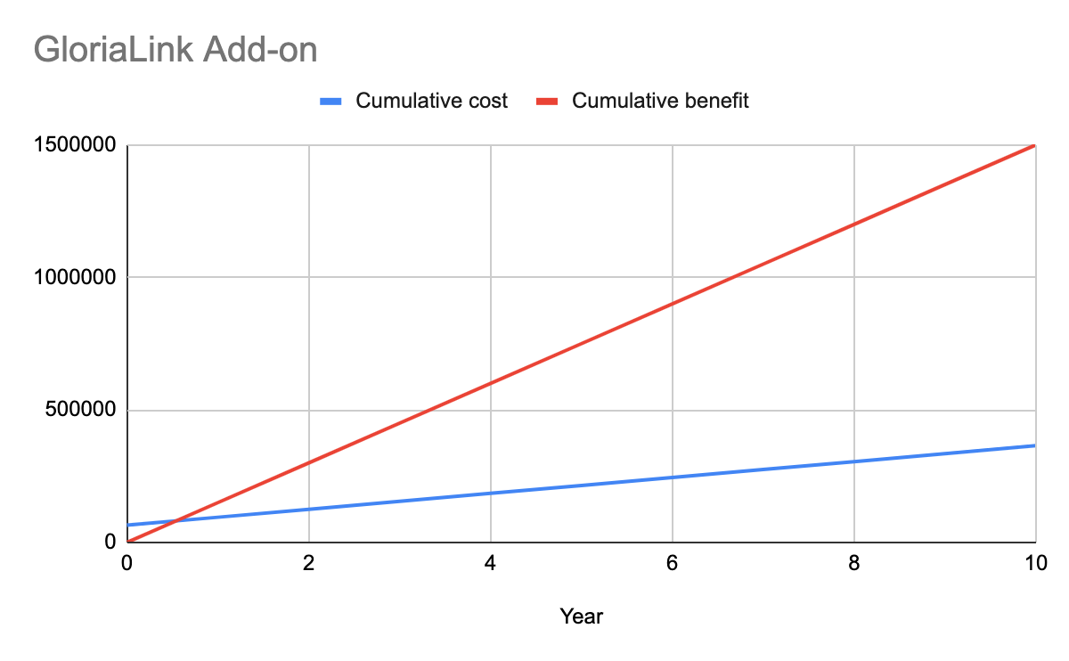
Candidate 3: GloriaLink Add-on
Item | Amount
Initial Cost | $65,000
Annual operating cost | $30,000
Annual Revenue gain | $125,000
Annual cost savings | $25,000
Total Benefit (10 yrs) | $1,500,000
Total Cost (10 yrs) | $335,000
Net benefit | $1,165,000
ROI | 348%
Payback period | ~1.3 years
NPV (10 yrs) | $774,000
Notes:
Pros -
Lowest initial cost ($65,000) with quickest payback (~1.3 years).
Best ROI (348%) among all — huge return for small investment.
Easy to deploy and inexpensive to maintain ($30,000 per year).
Cons -
Lower long-term benefit ceiling — no AI features or advanced workflows.
May struggle to scale with business growth.
Less control over system behavior and data.

Slide 14
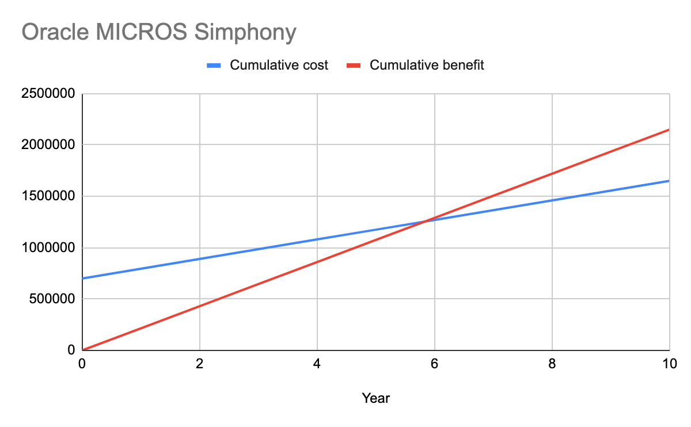
Candidate 4: Oracle MICROS Simphony
Item | Amount
Initial Cost | $700,000
Annual operating cost | $95,000
Annual Revenue gain | $180,000
Annual cost savings | $35,000
Total Benefit (10 yrs) | $2,150,000
Total Cost (10 yrs) | $1,565,000
Net benefit | $585,000
ROI | 37.4%
Payback period | ~4.3 years
NPV (10 yrs) | $506,000
Notes:
Pros -
Strong annual benefit ($215,000 per year) from rich enterprise features.
High-end, scalable system with extensive modules (good for large expansion plans).
Decent NPV of ($506,000) despite the high cost.
Cons -
Extremely high upfront costs ($700,000) and ongoing costs ($95,000 per year).
Lowest ROI (37.4%) — small return on a large investment.
Longest payback period (~4.3 years) and break-even only around year 5.
May be over-engineered for our current size and needs.

Slide 15
Summary
Criteria | Score
Feasibility matrix total | 91.5 (1st place)
ROI (10 years) | 98%
Net Benefit | $965,000
Payback Period | ~2.8 years
NPV (10 years @ 10%) | $753,000
Recommended System
Custom- built solution because it provides best balance of long-term value, operational alignment and strategic control.
Key reasons
Strategic fit, AI prioritization and contactless ordering, Strong ROI and NPV, Sustainable growth, ownership and flexibility.
Notes:
After a thorough feasibility analysis, a detailed ROI comparison, and evaluation of both functional and non-functional performance across all candidate systems, our team confidently recommends Custom building as the optimal solution for our enterprise.
The system although requiring one of the highest initial investment, is custom-built to meet the specific needs and growth trajectory of the organization. Unlike off the shelf SaaS solutions or plugin based hybrids, this is designed around our workflows, our kitchen infrastructure and our customer experience goals. It integrates AI-powered order prioritization, seamless mobile/tablet ordering, kitchen display systems, and contactless payment — all tailored to how we operate.
From a financial standpoint, the system delivers strong long-term returns. It breaks even in under three years, delivers a net benefit of nearly $1 million and maintains a high Net present Value of over $750 thousand over a 10-year horizon.
Compared with other candidates, custom building, offers the best balance between ROI and strategic alignment.
We also considered the cultural and operational impact. Because this solution is being developed with direct input from our servers, kitchen staff and managers, we anticipate smoother adoption and long term satisfaction. Additionally, owning the system gives us flexibility to adapt or expand it in the future without relying on third-party roadmaps or licensing restrictions.
In summary, Custom building isn’t just a technology choice — it’s a strategic investment in our operational efficiency, customer experience, and long-term growth. It’s a system designed to evolve with us, not just serve us today.

Slide 16
Database
Sample Inputs:
When a customer submits an order:
{
"customer_id": 123,
"items": [
{ "dish_id": 101, "quantity": 2 },
{ "dish_id": 205, "quantity": 1, "special_requests": "No peanuts" }
],
"payment_method": "Apple Pay"
}
Associate dish ID=101 (steak) with allergen ID=3 (dairy):
INSERT INTO Dish_Allergens (dish_id, allergen_id) VALUES (101, 3);
Customer ID=123 Allergic to allergen ID=1 (peanut):
INSERT INTO Customer_Allergies (customer_id, allergen_id) VALUES (123, 1);
Notes:
1. Stakeholder engagement:
It is assumed that all key stakeholders can provide the necessary feedback and support early in the project to ensure the accuracy of the project requirements.
Assume that management is actively involved in the project, providing the required resources and decision support.
2. Customer acceptance :
It is assumed that employees and customers will embrace the new system and be willing to participate in training to familiarize themselves with the new process.
3. Technical feasibility:
It is assumed that the selected technology solution can be successfully implemented within the established time and budget and can meet the functional requirements of the project.
4. Cooperation with external suppliers:
It is assumed that all external vendors (such as payment processors, technical support, etc.) can provide the necessary service and support on time.
5. Maintenance and Sustainability:
It is assumed that the restaurant will continue to invest the necessary resources in system maintenance and upgrades to ensure the long-term availability of the system.
It is assumed that the technical support team has sufficient expertise and capability to deal with system issues in a timely manner.
6. Regulatory compliance:
It is assumed that the design and implementation of the new system will comply with industry standards and relevant regulations to ensure data security and customer privacy.
7. Restaurant Infrastructure:
It is assumed that the restaurant's existing network infrastructure can handle the traffic of the new system without causing major performance issues.
It is assumed that all the necessary hardware and software components will be in place in time to support the implementation of the new system.

Slide 17
Database
Sample Outputs:
Order confirmation response：
{
"order_id": 5001,
"status": "Received",
"total": 58.99,
"allergy_warnings": [
{
"dish_id": 101,
"name": "Grilled Steak",
"allergens": ["Dairy"]
}
]
}
Kitchen orders see the data：
{
"order_id": 5001,
"items": ["Steak x2", "Pasta x1"],
"allergy_notes": "Allergy Alert: Dairy (Steak)"
}
Notes:
1. Stakeholder engagement:
It is assumed that all key stakeholders can provide the necessary feedback and support early in the project to ensure the accuracy of the project requirements.
Assume that management is actively involved in the project, providing the required resources and decision support.
2. Customer acceptance :
It is assumed that employees and customers will embrace the new system and be willing to participate in training to familiarize themselves with the new process.
3. Technical feasibility:
It is assumed that the selected technology solution can be successfully implemented within the established time and budget and can meet the functional requirements of the project.
4. Cooperation with external suppliers:
It is assumed that all external vendors (such as payment processors, technical support, etc.) can provide the necessary service and support on time.
5. Maintenance and Sustainability:
It is assumed that the restaurant will continue to invest the necessary resources in system maintenance and upgrades to ensure the long-term availability of the system.
It is assumed that the technical support team has sufficient expertise and capability to deal with system issues in a timely manner.
6. Regulatory compliance:
It is assumed that the design and implementation of the new system will comply with industry standards and relevant regulations to ensure data security and customer privacy.
7. Restaurant Infrastructure:
It is assumed that the restaurant's existing network infrastructure can handle the traffic of the new system without causing major performance issues.
It is assumed that all the necessary hardware and software components will be in place in time to support the implementation of the new system.

Slide 18
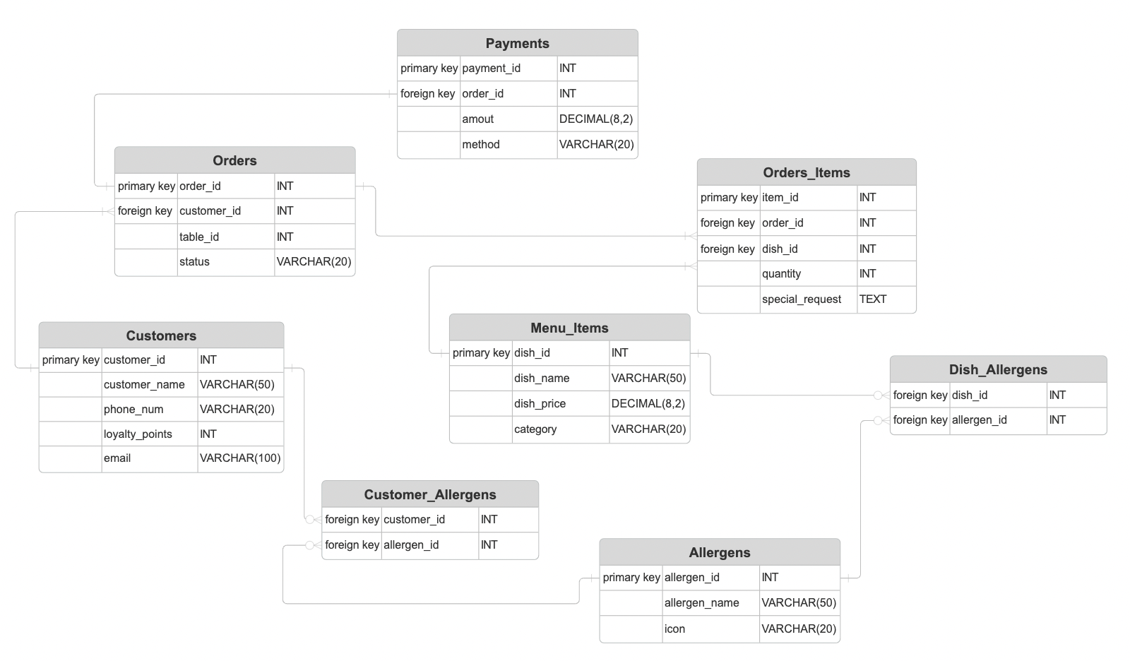
Table Review

Slide 19
Menu_Items table:
dish_id | dish_name | dish_price
101 | Grilled Steak | 24.99
Dish_Allergens table:
Allergens table:
allergen_id | allergen_id
101 | 2
allergen_id | allergen_name
1 | Peanuts
2 | Dairy

Slide 20
USER EXPERIENCE
CRITICAL TOWARDS USERS

Slide 21
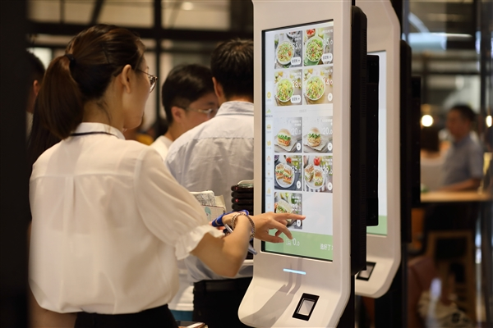
SYSTEM ACCESS
Mobile-first Design: Compatibility with tablets and mobile devices
Rich Internet Development: Benefits of multi-platform accessibility for diverse user demographics
Notes:
Our smart ordering system is designed for seamless accessibility across both tablet and mobile devices. Customers
can effortlessly browse the digital menu, place orders, and make payments using their preferred device. This
flexibility caters to diverse user preferences and ensures a convenient ordering experience. For instance,
integrating mobile ordering has been shown to enhance customer satisfaction by providing convenience and efficiency.

Slide 22

SAMPLE USER SCREEN
Key features of the user interface
Visual consistency and ease of navigation
Notes:
The user interface is intuitively designed with clear navigation and high-quality visuals. Key features include:
- Home Screen: Displays featured items and promotions.
- Menu Categories: Organized sections for easy browsing.
- Order Summary: Provides a detailed view of selected items before confirmation.
- Payment Gateway: Secure and supports multiple payment options.
This design ensures that users can navigate the ordering process effortlessly, enhancing their overall experience.
gksoft.co.uk

Slide 23

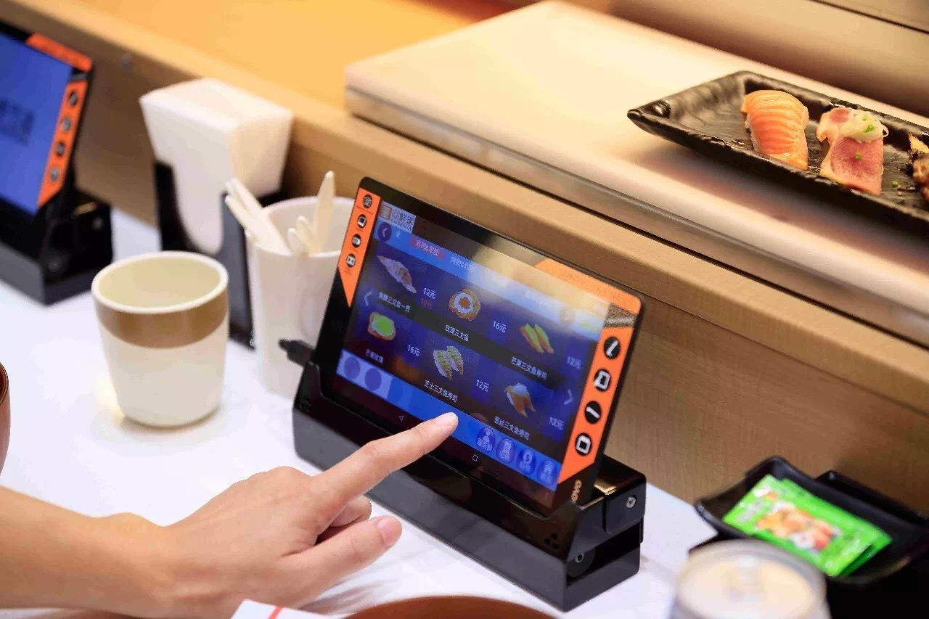
FEEDBACK & SURVEYS
Mobile survey applications
User engagement
Continuous improvement.
Notes:
Implementing mobile survey applications has revolutionized how we gather feedback. Customers can provide real-time
feedback through the app, leading to higher response rates and more accurate insights. Studies have shown that mobile
surveys offer convenience and accessibility, resulting in enhanced user engagement and valuable data for continuous
improvement.

Slide 24
IMPLEMENTATION
PLAN

Slide 25

TIMELINES & PHASES
PHASE 1 (Month 1-2) | PHASE 1 (Month 3) | PHASE 1 (Month 4)
System development and customization | Pilot testing in select locations to gather initial feedback | Full-scale deployment across all locations
Notes:
Our implementation strategy is structured into distinct phases:
- Phase 1 (Month 1-2): System development and customization.
- Phase 2 (Month 3): Pilot testing in select locations to gather initial feedback.
- Phase 3 (Month 4): Full-scale deployment across all locations.
This phased approach allows for addressing any challenges early and ensures a smooth transition.

Slide 26

STAFF TRAINING & ADOPTION
System Navigation
Troubleshooting
Customer Interaction
Notes:
Comprehensive training programs are essential for successful adoption. Training will focus on:
- System Navigation: Ensuring staff can assist customers effectively.
- Troubleshooting: Equipping staff to handle common issues.
- Customer Interaction: Maintaining service quality during the transition.
Effective training has been linked to improved efficiency and customer satisfaction.

Slide 27

RISK MITIGATION
Technical Glitches
Staff Resistance
Customer Adaptation
Notes:
To address potential risks:
- Technical Glitches: Implement robust testing protocols and have IT support readily available.
- Staff Resistance: Engage staff early in the process, highlighting benefits and providing incentives for adoption.
- Customer Adaptation: Offer on-site assistance and educational materials to ease the transition for customers.

Slide 28
CONSTRAINS & ASSUMPTIONS

Slide 29
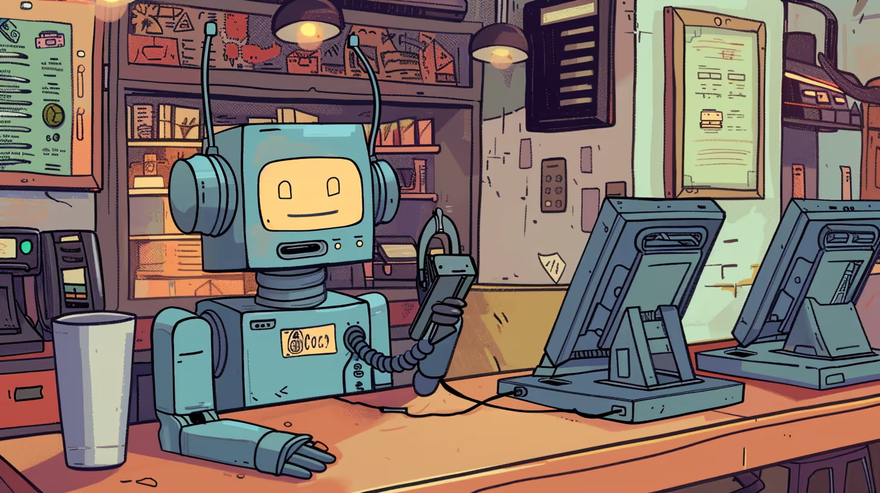
LIMITATIONS
Budget
Time
Technology
Notes:
- Budget: We have allocated a specific budget for this project, necessitating cost-effective solutions without
compromising quality.
- Time: The four-month timeline requires strict adherence to each phase to meet the launch deadline.
- Technology: Assumes the availability of necessary hardware and software, and compatibility with existing systems.

Slide 30
LEGAL & COMPLIANCE
Data security
Accessibility standards
Notes:
Compliance with data protection regulations is paramount. The system will incorporate robust security measures to
protect customer information. Additionally, accessibility standards will be met to accommodate all users.

Slide 31
CONCLUSION
Customer Satisfaction
Operational Efficiency
Financial Gains
Notes:
Implementing the smart ordering system is projected to enhance customer satisfaction, streamline operations, and
increase revenue. The anticipated return on investment includes higher average order values and improved table turnover
rates.
- Customer Satisfaction: Enhanced through a user-friendly interface and efficient service.
- Operational Efficiency: Achieved via streamlined ordering and payment processes.
- Financial Gains: Realized through increased order accuracy, higher average order values, and reduced labor costs.

Slide 32

QUESTIONS?
Notes:
The core features are designed to address current inefficiencies.
AI-powered order management will enhance kitchen productivity.
Customers and staff will have real-time updates on order status.
Secure and flexible payment options will improve convenience.

